Slide 1
Module 5 – ANOVA

Slide 2
Analysis of variance (ANOVA)
Analysis of variance (ANOVA) is used as a test of relationships between variables. ANOVA must have:
1 continuous dependent variable
1 or more independent variables (factors) that are all categorical
A particular combination of factors is called a treatment
One-way analysis of variance involves only 1 factor
If 2 or more factors are involved, the analysis is called n-way analysis of variance
Other variations: analysis of covariance (ANCOVA), Multivariate analysis of variance (MANOVA)

Slide 3
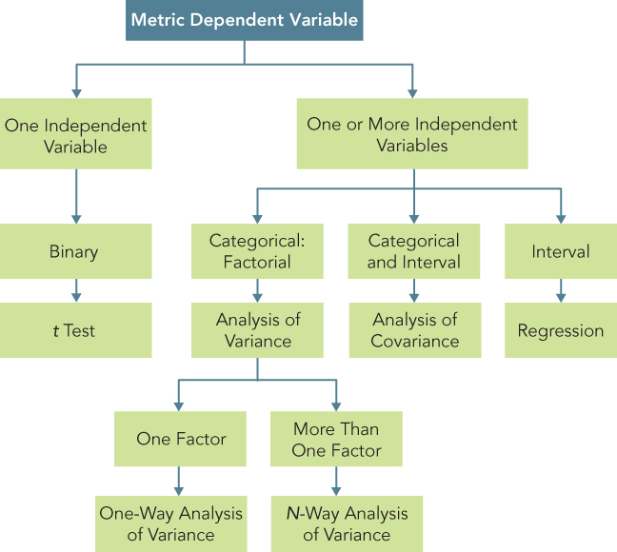
Relationship Amongst Test, Analysis of Variance, Analysis of Covariance, & Regression

Slide 4
One-Way ANOVA
Researchers are often interested in examining the differences in the mean values of the dependent variable across several categories of a factor. For example:
Do the various segments differ in terms of their volume of product consumption?
Do the brand evaluations of groups exposed to different commercials vary?
What is the effect of consumers' familiarity with the store (measured as high, medium, and low) on preference for the store?

Slide 5
One-Way ANOVA Procedure
Step 1: State the null and alternative hypotheses
Null hypothesis: All means of a variable are equal across all levels of a factor (i.e. The factor has no effect on the variable)
H₀: µ₁ = µ₂ = µ₃ = ........... = µ_{c}
Alternative hypothesis: Not all means of a variable across all levels of a factor are equal (i.e. The factor does have an effect on the variable)
Step 2: Calculate the test statistic (F-stat)
Step 3: Choose a level of confidence (e.g. 95%). Calculate critical value and p-value associated with test statistic
If p-value < 0.05 -> Reject H₀
If p-value > 0.05 -> Do not reject H₀

Slide 6
Example: One-Way ANOVA
Use marketing data on Coupon Level, In-Store Promotion, Sales, and Clientele Rating
Store Number | Coupon Level | In-Store Promotion | Sales | Clientele Rating
1 | 1 | 1 | 10 | 9
2 | 1 | 1 | 9 | 10
3 | 1 | 1 | 10 | 8
4 | 1 | 1 | 8 | 4
5 | 1 | 1 | 9 | 6
6 | 1 | 2 | 8 | 8
7 | 1 | 2 | 8 | 4
8 | 1 | 2 | 7 | 10
9 | 1 | 2 | 9 | 6
10 | 1 | 2 | 6 | 9
11 | 1 | 3 | 5 | 8
12 | 1 | 3 | 7 | 9
13 | 1 | 3 | 6 | 6
14 | 1 | 3 | 4 | 10
15 | 1 | 3 | 5 | 4

Slide 7
Example: One-Way ANOVA
Use marketing data on Coupon Level, In-Store Promotion, Sales, and Clientele Rating
Store Number | Coupon Level | In-Store Promotion | Sales | Clientele Rating
16 | 2 | 1 | 8 | 10
17 | 2 | 1 | 9 | 6
18 | 2 | 1 | 7 | 8
19 | 2 | 1 | 7 | 4
20 | 2 | 1 | 6 | 9
21 | 2 | 2 | 4 | 6
22 | 2 | 2 | 5 | 8
23 | 2 | 2 | 5 | 10
24 | 2 | 2 | 6 | 4
25 | 2 | 2 | 4 | 9
26 | 2 | 3 | 2 | 4
27 | 2 | 3 | 3 | 6
28 | 2 | 3 | 2 | 10
29 | 2 | 3 | 1 | 9
30 | 2 | 3 | 2 | 8

Slide 8
Example: One-Way ANOVA
The department store is attempting to determine the effect of in-store promotion (X) on sales (Y). There are 3 levels of promotion (1, 2, 3)
Step 1: State the hypotheses
H₀: Average sales are equal across all levels of promotion (i.e. Promotion has no effect on sales)
Step 2: Calculate the F-statistic
Step 3: Calculate the critical value p-value associated with F-statistic
F-statistic = 17.9, p-value ~ 0 -> Reject H₀ and conclude that levels of promotion has an effect on sales

Slide 9
N-Way ANOVA
In research, one is often concerned with the effect of more than one factors simultaneously. For example:
How do advertising levels (high, medium, and low) interact with price levels (high, medium, and low) to influence a brand's sale?
Do educational levels (less than high school, high school graduate, some college, and college graduate) and age (less than 35, 35-55, more than 55) affect consumption of a brand?
What is the effect of consumers' familiarity with a department store (high, medium, and low) and store image (positive, neutral, and negative) on preference for the store?

Slide 10
N-Way ANOVA Procedure
Step 1: State the null and alternative hypotheses. There are different sets of null and alternative hypotheses that can be tested with N-way ANOVA.
H₀: A factor has no effect on a variable
H_{a}: A factor does have an effect on a variable
H₀ : A combination of factors has no effect on a variable
H_{a} : A combination of factors does have an effect on a variable
Step 2: Calculate the F-statistic (ANOVA uses the F-test).
Step 3: Choose a level of confidence (e.g. 95%). Calculate critical value and p-value associated with test statistic
If p-value < 0.05 -> Reject H₀
If p-value > 0.05 -> Do not reject H₀

Slide 11
Example: N-Way ANOVA
Use marketing data on Coupon Level, In-Store Promotion, Sales, and Clientele Rating
Step 1: State the null and alternative hypotheses. For example,
H₀: Promotion has no effect on sales
H_{a}: Promotion has an effect on sales
H₀ : Promotion and coupon together have no effect on sales (Promotion level does not affect coupon’s impact on sales)
H_{a} : Promotion and coupon together have an effect on sales (Promotion level will affect coupon’s impact on sales)

Slide 12
Example: N-Way ANOVA
Step 2: Calculate the test statistic
Step 3: Choose a level of confidence (e.g. 95%). Calculate critical value and p-value associated with test statistic
p-value ~ 0 for Coupon, Promotion. Reject H₀. Conclude that:
Coupon alone has an effect on sales
Promotion alone has an effect on sales
p-value = 0.206 for Coupon*Promotion (combination or interaction of coupon and promotion). Do not reject H₀. Conclude that:
Coupons and Promotion together do not have an effect on sales (i.e. Promotion level does not affect coupon’s impact on sales)

Slide 13
Analysis of Covariance (ANCOVA)
When examining the differences in the mean values of the dependent variable related to the effect of the controlled independent variables, it is often necessary to take into account extra independent (often continuous) variables (called covariates). For example:
In determining how different groups exposed to different commercials evaluate a brand, it may be necessary to control for prior knowledge
In determining how different price levels will affect a household's cereal consumption, it may be essential to take household size into account

Slide 14
Multivariate Analysis of Variance (MANOVA)
Multivariate analysis of variance (MANOVA) is similar to analysis of variance (ANOVA), except that it has 2 or more dependent variables
In MANOVA, the null hypothesis is that the means of multiple dependent variables are equal across different levels of factors.
MANOVA is appropriate when there are two or more dependent variables that are correlated.

